Slide 1
Using Career Planning & Discovery to Jump Start the Job Search
DDS Employment Conference 2019
Presenters:
Jill Eastman
Lara Enein-Donovan
Dora kamenidis
Institute for Community Inclusion/Umass Boston
<<Select your logo if you want one. These can be resized or deleted.
<<The CHB logo can be removed if you want.

Slide 2
Think About Your Own Experience
What was your career journey like to get to where you are today?
  When did it start?
  How did it start?
  What discoveries were made along the way?
  How did they determine your next course of action?

Slide 3
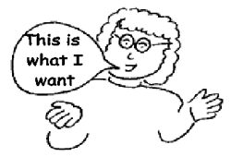
Current Practice:
Career Planning is based on job seeker’s interests & desires…
Not just on what
(s)he “can do”!

Slide 4
Good Career Planning
Bring together people who know job seeker
  Respect the choices of the job seeker
  Tap into those resources! Learn what (s)he knows
2. Use a Facilitator
- Keep positive tone - Avoid “yes, but..”
3. Develop Vocational Profile (Job Dev’t Planning tool)
Explore:
  Likes & dislikes - Skills/abilities/talents/hobbies
  Past experiences - Learn “why” choices are made
4. Identify Employment Goal/Outcome
  Job choice - Environment choices
5. Develop Placement Plan
  What’s needed & who can help? Recruit their help!
  Evaluate & update the plan regularly

Slide 5
Considerations for
Involving Others in Planning
How well do they know the job seeker?
Can they contribute to planning?
Are they willing to participate/follow thru on tasks?
Consider family, friends, professionals & employers
Each plan & each process is different
Some job seekers want employment specialist alone, others want to call people for their opinions, and others want a large meeting

Slide 6
Get Beyond Tasks & Skills
Name environments the individual enjoys
In what environments has person succeeded?
What social skills does person have?
In what environments would his/her personality & social skills be an asset?
What work environments should be avoided & why?

Slide 7
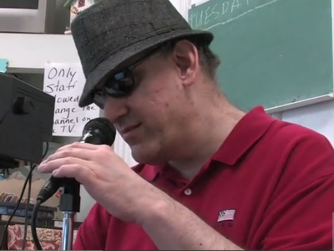
Chris’ Video

Slide 8
What if you still need more information?
You have asked all the right questions
Meet with the job seeker a number of times…
But are still unsure of good job matches and/or job tasks..now what do you do?

Slide 9
Using Discovery Techniques includes:
Interviewing team members to get more details
Observing the job seeker in various activities and in different environments (not just work activities)
Spend time together (not just in the office or on work related activities)
Review records to see what’s been missed

Slide 10
How to facilitate the Discovery process
Meet with job seeker and family
Visit their home, scout out their neighborhood noting businesses, transporation..etc
Compile an inventory of businesses they can get to
Interview team members (with job seekers permission)

Slide 11
Personal Profile
*Search for Opportunities & Talents*
History (living, working, learning, recreation)?
Relationships?
Places - worked, want to work?
Preferences & desires for employment?
Are there environmental factors to consider?
Situational assessment can help explore tasks & environments

Slide 12
Positive Personal Profile
An inventory of all the attributes of an individual for employability
Looks at a range of factors including:
  Dreams and goals
  Learning styles
  Positive personality traits

Slide 13
Resources for Discovery and the Personal Profile
The Job Developer’s Handbook by Cary Griffin, David Hammis & Tammara Geary
Customized Employment: Applying Practical Solutions for Employment Success https://www.dol.gov/odep/documents/2e984b1d_f2de_40dd_b3c4_3b4073b67ca5.pdf

Slide 14
Tie the ISP Goals into the Plan
How can job development activities help work towards meeting ISP goals?
  Safety/travel skills
  Communication skills
  Hygiene improvement
  Organizational skills

Slide 15
Tie in the ISP goals: Examples
Travel training/safety skills
  Take public transport/walk and teach skills along the way
Communication Skills
  Teach and practice talking to people at various businesses
Others?

Slide 16
More Career Planning Resources
Increasing Person-Centered Thinking: Improving the Quality of Person-Centered Planning - A Manual for Facilitators (Univ. of Minnesota)
http://rtc.umn.edu/docs/pcpmanual1.pdf
A Guide for Career Discovery (Missouri)
www.mpcdd.com/pageDownload.php?docID=3354
I Want to Work Workbook and companion Partner Guide
(Virginia Commonwealth University)
http://www.personcenteredpractices.org/work_workbook.html

Slide 17
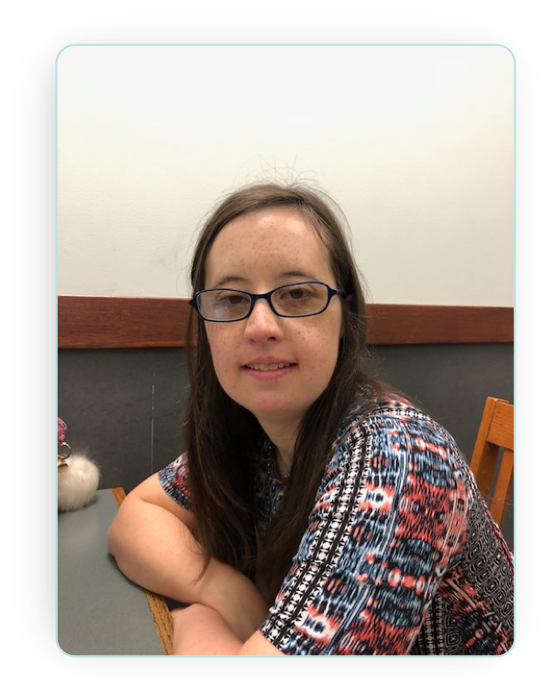
Molly’s Story

Slide 18
FINAL THOUGHTS OR QUESTIONS FOR THE DAY?

